Slide 1


Make Up products site

Slide 2
What is up next?
Category/brand pages
Sign in for users, order summery.
More animations.

Slide 3
Special thanks to the angles in capsule 4: Ayelet, Eyal, Adi
Also- Thank you Itay, Evgeni and Natalie

Slide 4
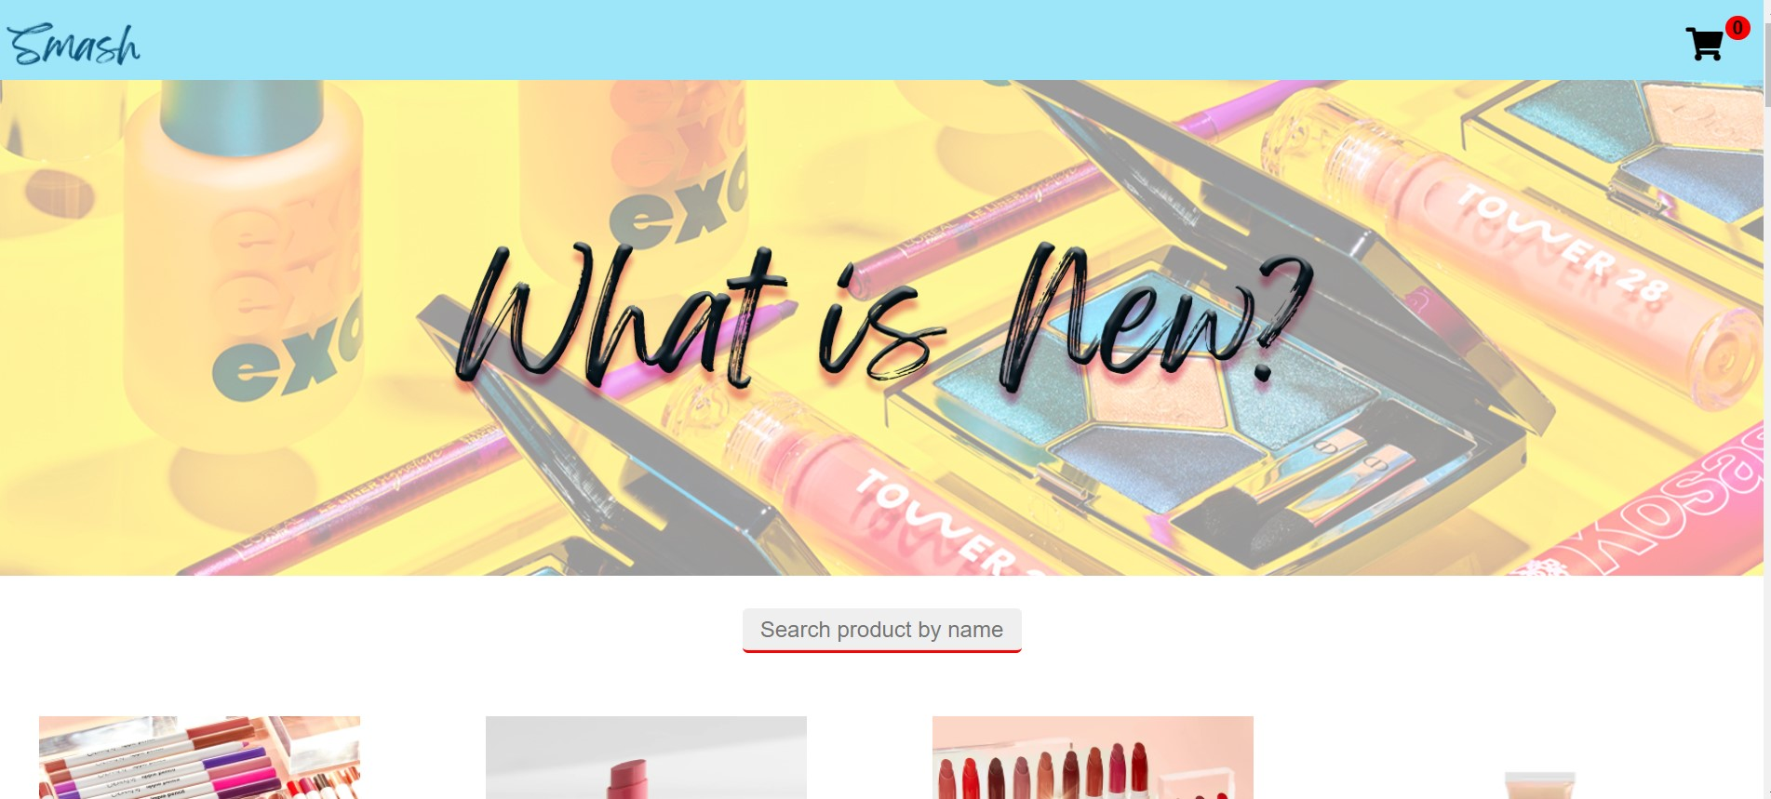

Slide 5
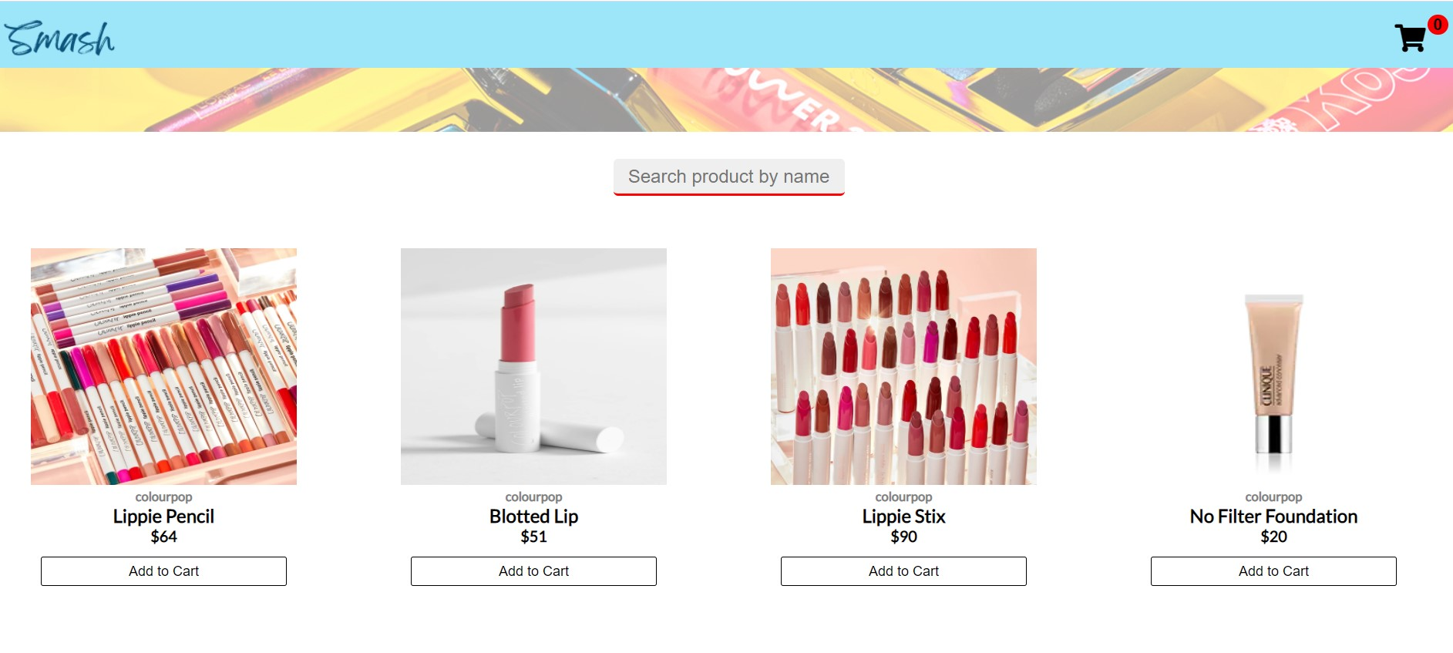

Slide 6
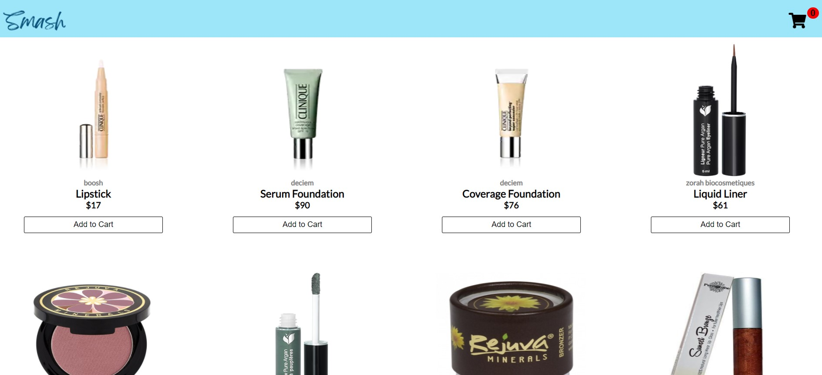

Slide 7
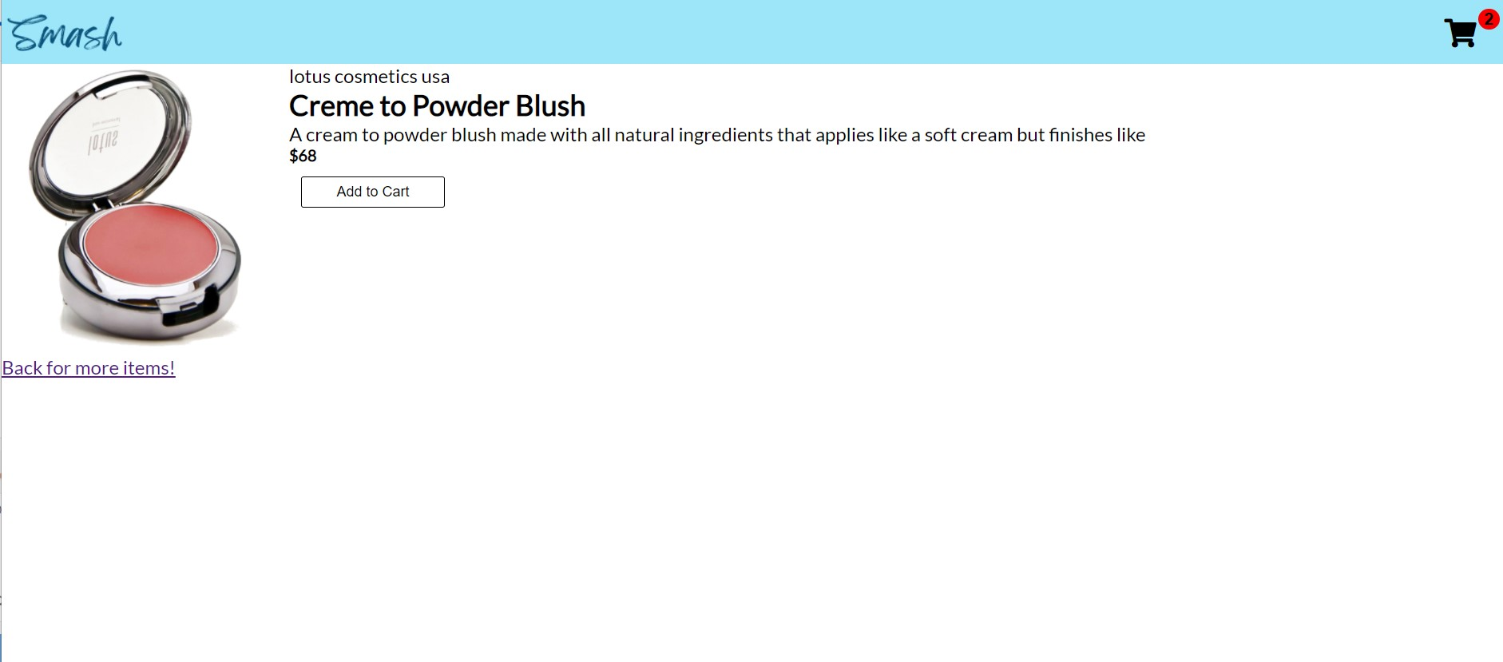

Slide 8
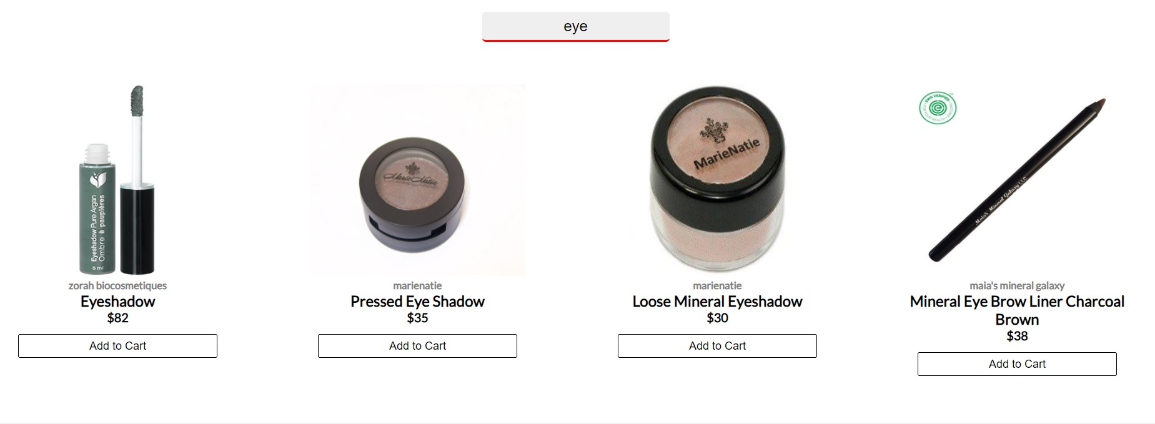

Slide 9
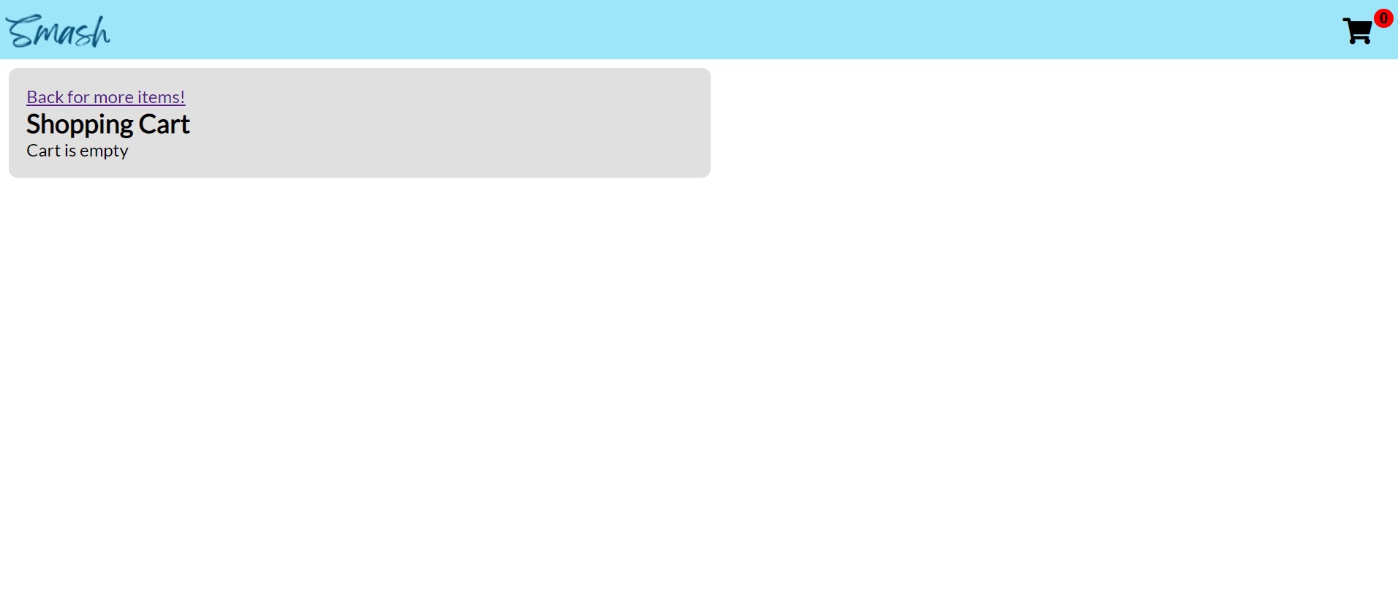

Slide 10
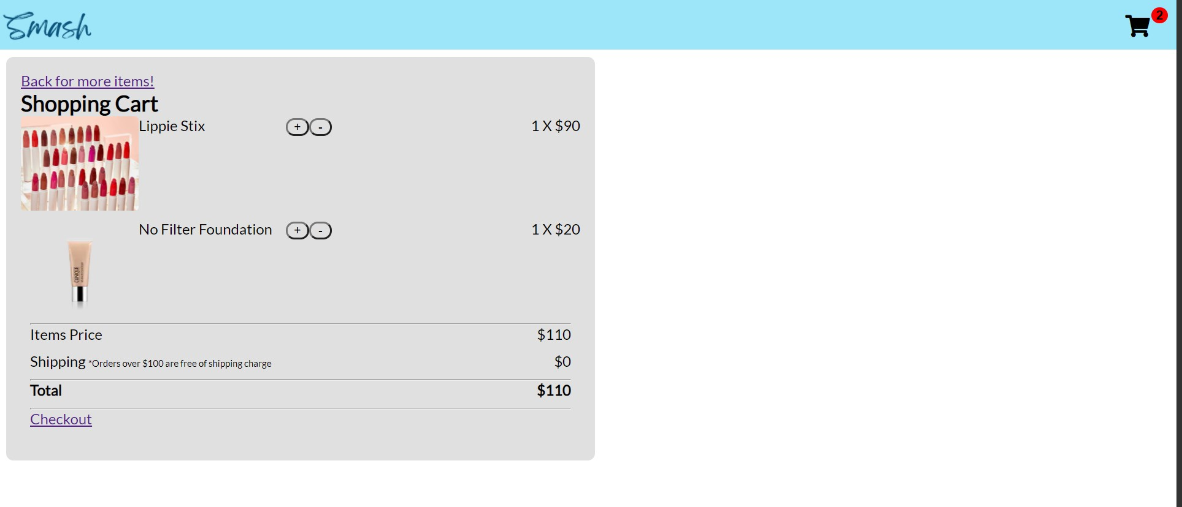

Slide 11
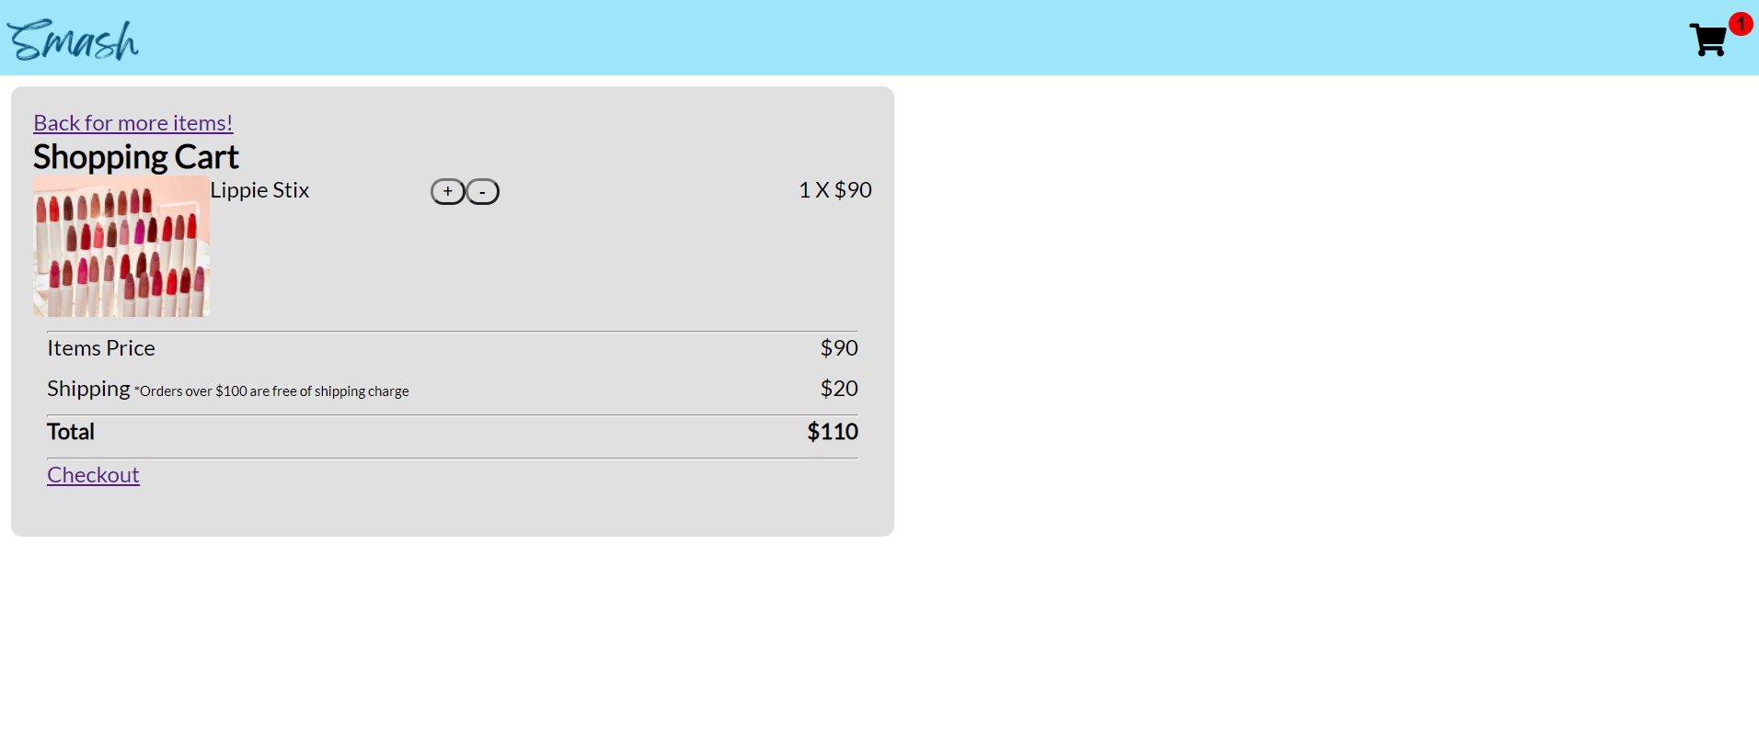

Slide 12
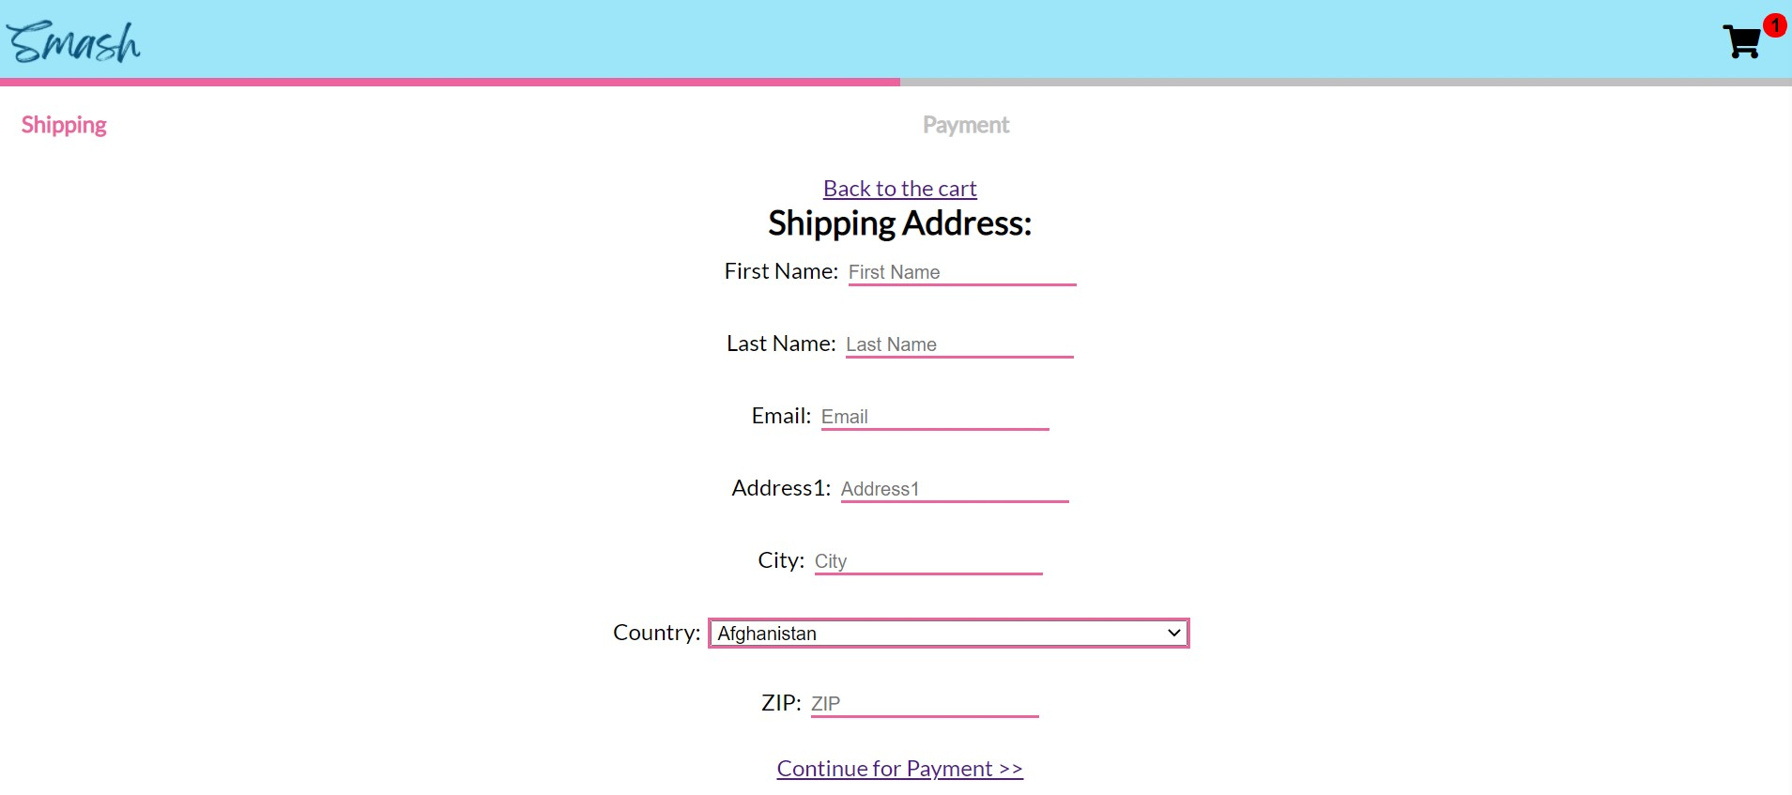

Slide 13
